Slide 1
Audio LLM research weekly report – Week 3
Hongyu Jin
Notes:
Most of what I am talking about is covered in the guidelines for use, found at the front of the RDA.

Slide 2
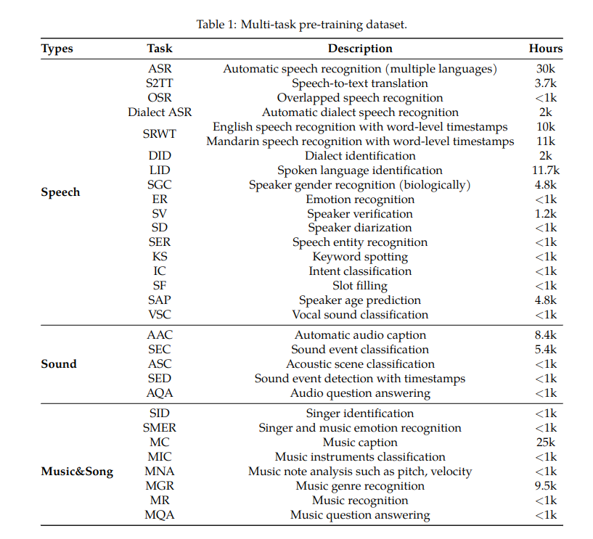
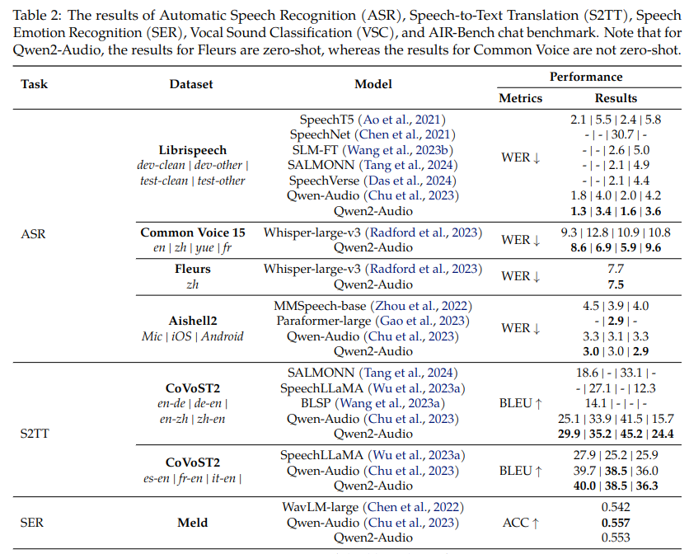
ERC task and benchmark
Notes:
The purpose of the RDA is to provide a legal mechanism for the retention & disposal of university records in accordance with legislative instruments and regulations issued under the Public Records Act 1973.
The Authority also -
identifies records which are required to be preserved permanently as part of the University’s archival heritage;
prevents the premature destruction of records which need to be retained for a specified period to satisfy legal, financial and other requirements of public administration;
specifies the minimum, and in some cases maximum, periods for which records are required to be retained;
authorises the destruction of those records not required permanently; and
mandates the prompt destruction of records as required under the Information Privacy Act 2000 and other instruments

Slide 3
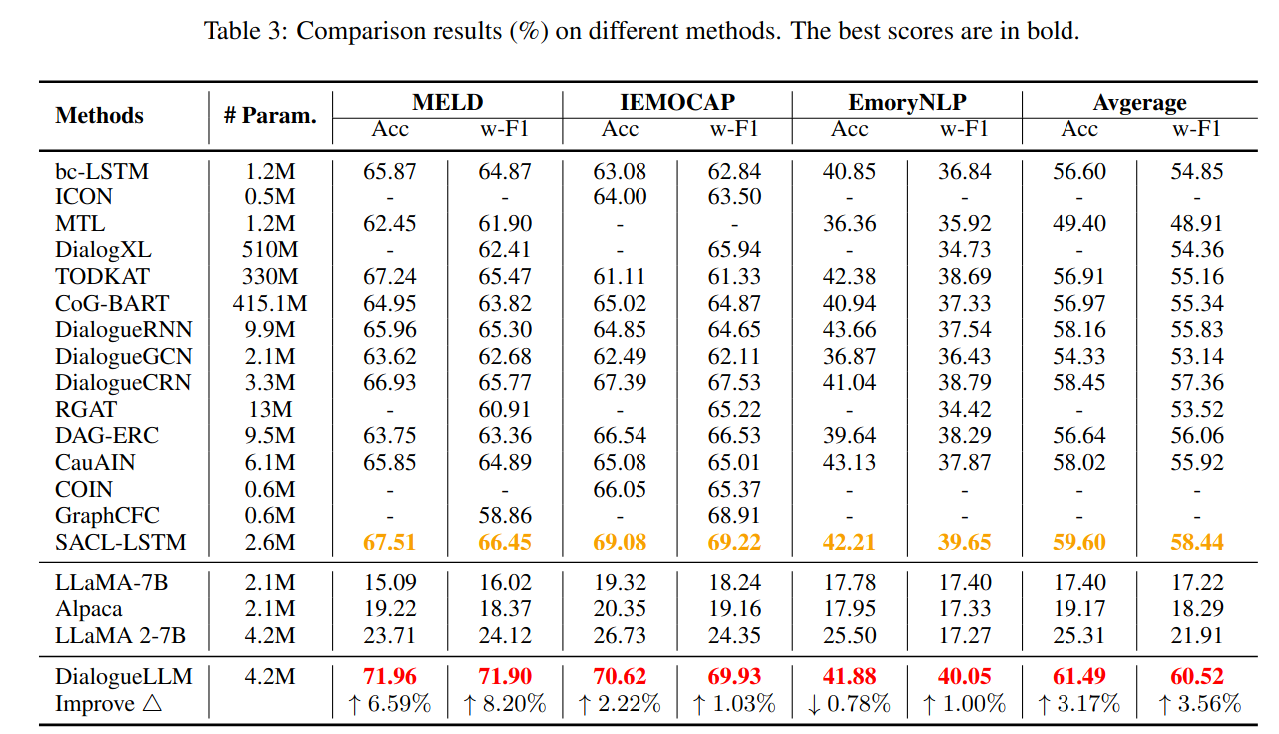
ERC task and benchmark

Slide 4
Dataset
IEMOCAP
MELD
MOSEI
EmoWOZ
CRRMA-D
“joy”,
“happy” “happiness”
Nomalize label
“happiness”
Notes:
The University of Melbourne Records Retention and Disposal Authority (RDA) is
“…the University document that sets out requirements for retention and disposal of all types of records, in line with legislative requirements and University business needs…”
(Records Management Policy MPF1106)
Records Services is responsible for developing the RDA
The University Archivist, Legal Services and the Director, Internal Audit are also consulted
The final document is approved by the University Secretary
(Records Management Policy MPF 1106, Records Retention and Disposal Procedure MPF1109)

Slide 5
Dataset format
{
"id": "sample_001",
"audio": {
"path": "path/to/audio1.wav",
},
"text_context": [
{"speaker": "User", "text": "I just finished my project presentation."},
{"speaker": "Assistant", "text": "How did it go?"}
],
"target_utterance": {
"text": "It was terrible. Nobody seemed interested and my boss barely looked up.",
"emotions": {
"primary": "disappointed",
"secondary": "frustrated",
}
},
"desired_response": {
"text": "I'm sorry to hear your presentation didn't get the reception you hoped for. That must be really disappointing, especially after all your preparation. Did you get any feedback that might be helpful, or would you like to talk about what aspects felt particularly frustrating?",
"response_strategy": "validation_then_exploration",
"emotion_awareness": "acknowledges_disappointment_and_frustration"
}
},
Notes:
What records does the RDA apply to?
The RDA applies to University records only. A University record is defined as “…any record comprised of recorded information, in any format, created or received by staff of the University in the course of conducting their University duties…”
(Records Management Policy MPF1106)

Slide 6
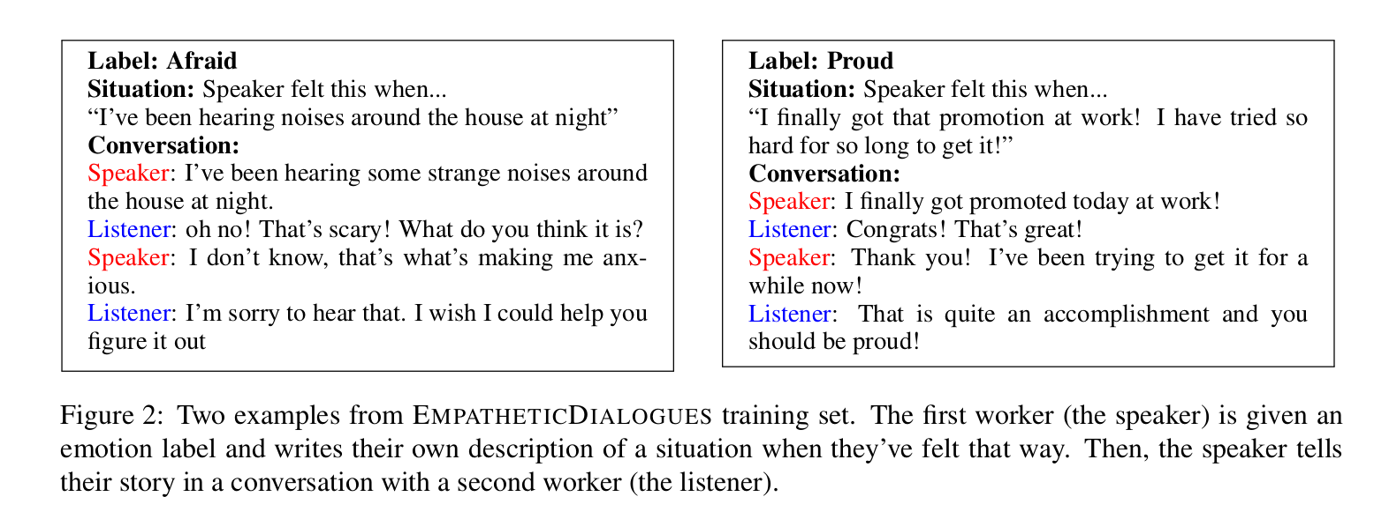
What about records of semi-autonomous bodies or subsidiary companies?
Comfort user?
Fight back?
Make a joke?
Stradegy?
Notes:
So what about records of semi-autonomous bodies or subsidiary companies?
Records of University business operations (or semi-autonomous bodies – these are listed in the Annual Report & include the Melbourne Theatre Company, Asialink, Melbourne University Sport etc) are University records.
Records of University subsidiaries, i.e. University controlled entities (listed in the Annual Report & include Melbourne University Publishing, Melbourne University Student Union etc), are not University records & the RDA does not apply. Subsidiaries are responsible for managing their own records in accordance with any relevant legislation.
However, all records created by or provided by the University in connection with its dealings with semi-autonomous bodies and subsidiaries are University records.

Slide 7
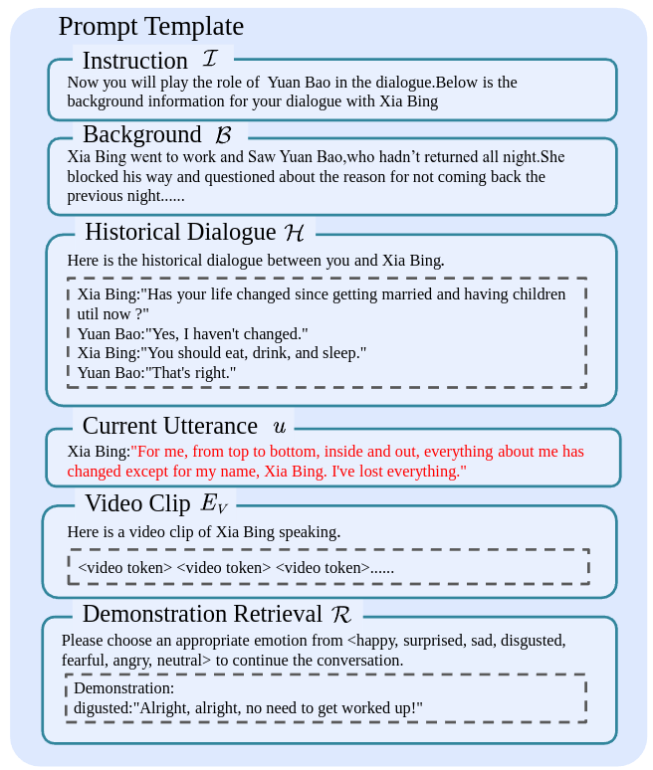
How to make a prompt template
For negative emotions (sadness, anger, fear, etc.):
Validation/Acknowledgment - Recognizing the emotion without judgment
Empathetic response - Showing understanding of the feeling
Problem-solving - Offering solutions or asking how you can help
Redirection - Gently shifting focus to more constructive thoughts
De-escalation - Calming techniques for intense emotions
Normalization - Reassuring that such feelings are normal
For positive emotions (happiness, excitement, pride, etc.):
Celebration/Amplification - Reinforcing and joining in the positive emotion
Inquiry - Asking to learn more about the positive experience
Gratitude expression - Expressing appreciation for sharing good news
Reciprocal enthusiasm - Matching their energy level
Future-oriented discussion - Building on the positive momentum
For neutral or mixed emotions:
Clarification - Seeking to better understand the emotional state
Open-ended questioning - Inviting deeper exploration
Mindful presence - Simply being present without directing the conversation
Summarization - Reflecting back the content and emotional undertones
I'll provide examples of these strategies in the context of dialogue responses to different emotions.

Slide 8
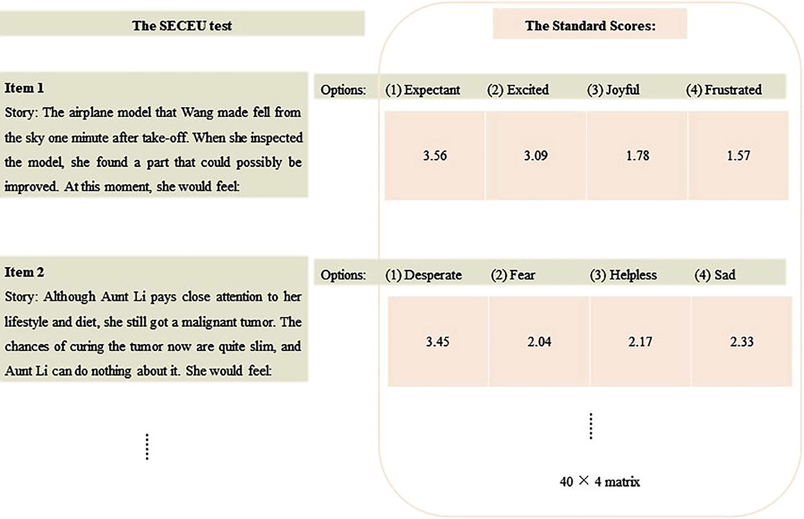
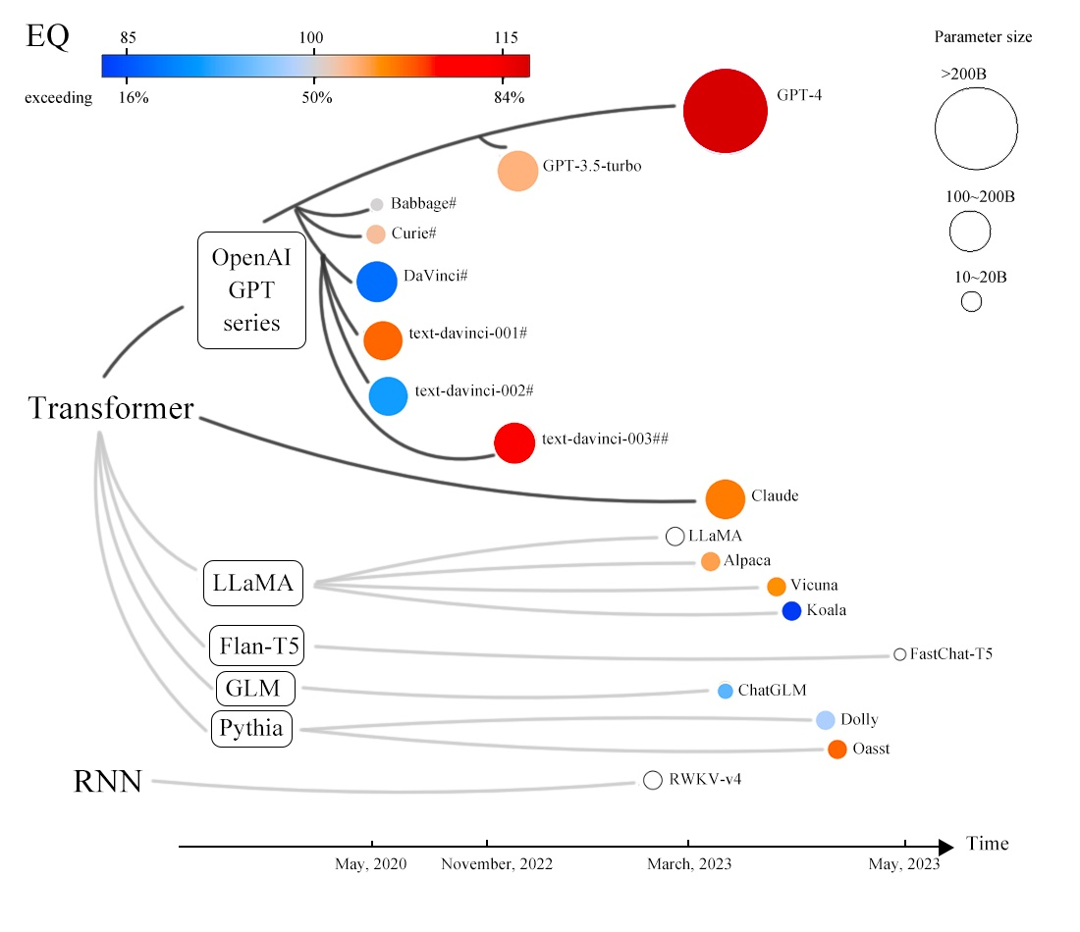
Evaluation
Notes:
Are there any records which can be destroyed without using the RDA?
Certain types of university records and information can be destroyed at any time without reference to this authority under what we call normal administrative practice or NAP. NAP covers the destruction of ephemeral material of a facilitative nature created, acquired or collected by university officers during the course of their duties.
The following material may be destroyed under NAP:
working papers consisting of rough notes and calculations used solely to assist in the preparation of other records such as correspondence, reports and statistical tabulations;
drafts not intended for retention as part of the office’s records, the content of which has been reproduced and incorporated in the university office's record keeping system;
extra copies of documents and published material preserved solely for reference (e.g. copies of minutes and agendas);
publications, superseded manuals, catalogues and trade journals held for informational purposes only;
unsolicited advertising material; and
copies.

Slide 9


© Copyright The University of Melbourne 2011

